Slide 1
School Health Advisory Council (SHAC)
School Health Advisory Council (SHAC)
Annual Report to the Board of Trustees
Monday, April 8, 2024
Annual Report to the Board of Trustees
MONDAY, APRIL 8, 2024
Notes:
Presenter: Allison
Time: 30 seconds
Say: Madame President, Board of Trustees, Dr. Smith and all others in attendance. I am happy to report on the annual report of the School Health Advisory Council, or SHAC.
The School Health Advisory Council (SHAC) is a parent and community advisory group mandated by legal and local policies (EHAA, EHAC). The majority of SHAC members are parents; the remaining members include district coordinated
school health representatives and community members.

Slide 2
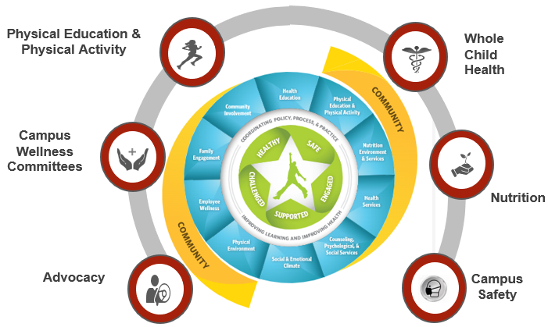
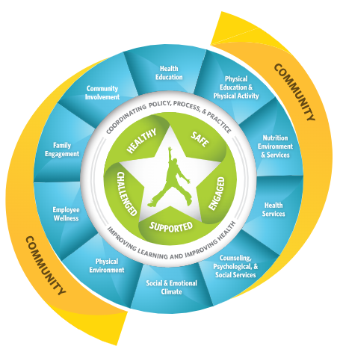
SHAC as a Resource
Support Campuses
Help schools meet community involvement mandates and community expectations
Encourage Collaboration
Provide a way for parents and community members to work together with school personnel to accomplish district goals, utilize community resources and assets
Build Capacity
Educate community members to be a credible, collective voice for healthy children and youth
Provide Health, Wellness, & Safety Resources
Provide a forum for sharing youth health information, resources, perspectives and a range of advice
Notes:
Presenter: Allison
Time: 30 seconds
Say: In the 2023-2024 school year, SHAC has been a resource for the school district in the following ways:
Supporting the campuses.
Encouraging collaborations
Building capacity
Providing health, wellness and safety resources

Slide 3
SHAC Goals
SHAC Legislative Priorities
Student Wellness Committees
Campus Improvement Plans Re: Wellness
Increase support and awareness of Student Wellness Committees & recognition of their sponsors
Ensure Campus Improvement Plans include wellness strategies created by their Campus Wellness Committee
Develop a process for SHAC to provide input on Board adopted Legislative Priorities
Action Based Learning
Gun Safety & Storage
Mental Health Supports
Develop a process for the District to provide families with gun safety and storage information
Recommend expansion of Action Based Learning Labs and including movement in classrooms (all levels)
Expand District level mental health supports available to ALL students
Notes:
Presenter: Allison
Time: 3 minute
Say: These were the 6 goals that SHAC focused on in 2023-2024. (Elaborate)

Slide 4
SHAC Legislative Priorities
The FBISD SHAC Supports:
Measures encouraging physical fitness and Action Based Learning, including effective use of fitness assessments.
Funding for a multi-tiered system of mental and behavioral health support that fosters safe and healthy school environments for students, educators, and staff.
Measures to ensure that all children receive access to healthy school meals, including breakfast and lunch to reduce food insecurity and hunger.
Notes:
Presenter: Allison
Time: 3 minute
Say: Our first goal during this school year was designing 6 Legislative Priorities, and SHAC has narrowed it down to these three. We hope that the BOT will take note of these LPs and possibly incorporate one or parts of these, into their BOT LP. These are the measures that we the SHAC support, and encourage individuals to advocate for. Reaching out to our representatives was encouraged to all the SHAC members and guests. Being involved in the legislative process is important.

Slide 5
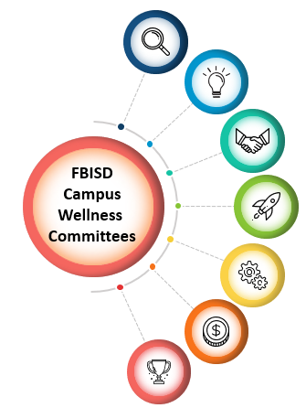
Mental Health Supports for Students & Staff
Whole Child Health Parent & Student Success Webinars
Promote Mental Health Supports
Provide Awareness of the District’s Multi-Tiered System of Support (MTSS)
Whole Child Health Campus Events & Initiatives
Notes:
Presenter: Allison
Time: 3 minute
Say: The last of our goals this year was to Expand District level mental health supports available to ALL students. We believe we still have room for improvement, and have elaborated on this goal for the upcoming school year, as you’ll see in a moment.

Slide 6
SHAC Accomplishments
Campus Wellness Committees 100% Participation
Student Wellness Committees & Sponsor Recognitions - 100% Participation
2nd Annual Think Tank
District Student Wellness Coalition: Inaugural year
72% of Campuses with Wellness CIP Strategies
Adoption of Fentanyl Poisoning Awareness Curriculum 2024
Process Developed for SHAC to Provide Legislative Priorities to Board of Trustees
Triennial Wellness Policy Review
Student Wellness Event (4/20/24)
Notes:
Presenter: Allison
Time: 3 minute
Say: These are accomplishments that the SHAC has accomplished, or is in the process of completing. (Elaborate.)

Slide 7
Think Tank
Student Wellness Committees (SWC) identified an issue/dilemma that their campus faces related to student mental, physical, or nutritional health.
SWC’s devised a solution to help address their campus’ issue.
Grant funds awarded from United HealthCare
$800
$1200
$500
Notes:
Presenter: Allison
Time: 30 seconds
Say: This was our 2nd year to host the FBISD SHAC/United HealthCare Think Tank. Student Wellness Committees (SWC) identified an issue/dilemma that their campus faces related to student mental, physical, or nutritional health. SWC’s devised a solution to help address their campus’ issue. Grant funds awarded from United HealthCare were 1200, 800 and 500 dollars. We want to thank UHC for this generous donation for our students and their campus projects.

Slide 8
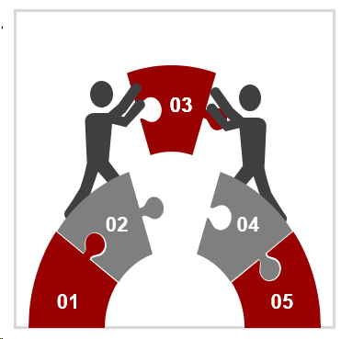
SHAC Recommendations for 2024-2025
Increase awareness and actionability of Student Wellness Committees and recognition of their sponsors
Develop a process for the District to provide families with gun safety and storage information
Recommend and explore Best Practices for cell phone use on campuses
Recommend expansion of Action Based Learning Labs and including movement in classrooms (all levels).
Evaluate the feasibility of high school starting later
Expand District-level mental health supports available to ALL students and evaluate and improve the effective and time-sensitive access of Multi-Tiered System of Support
Ensure Campus Improvement Plans include wellness strategies created by their Campus Wellness Committee
For more information about FBISD SHAC, visit www.fortbendisd.com/SHAC, follow us on Twitter @FBISD_SHAC or contact the SHAC Chair at chairfortbendisdshac@gmail.com
Notes:
Presenter: Allison
Time: 3 minute
Say: Moving forward, the SHAC has the following recommendations for the 2024-2025 school year. (Elaborate).

